Slide 1
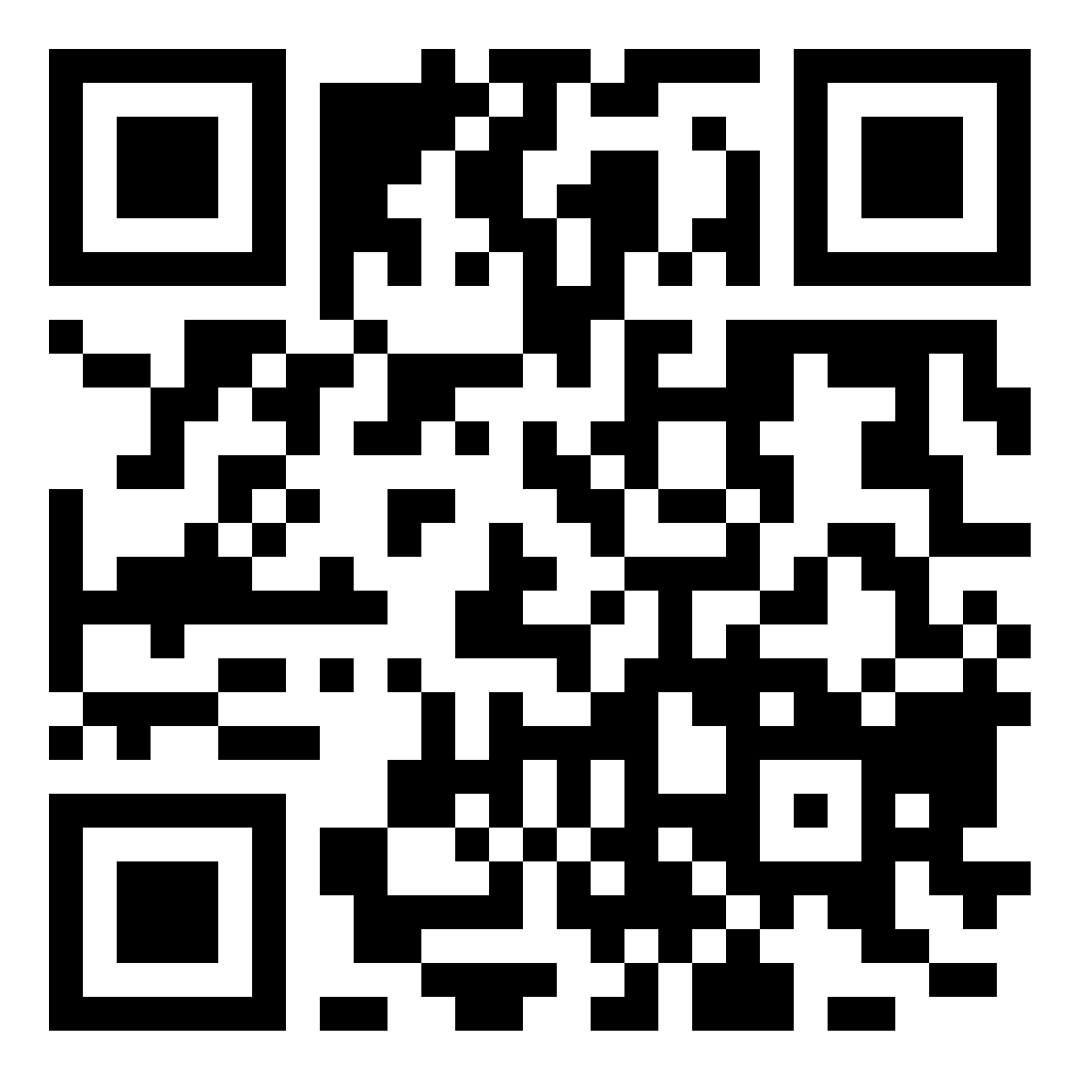
SETTING UP GREEN ENERGY RESEARCH IN SERBIA
SUNRISE
ABOUT US
SUNRISE project aims to leverage the scientific excellence and research and administrative capacity of the University of Belgrade through knowledge transfer and the exchange of best practices with
well-established research institutions from the Netherlands and Spain.
OBJECTIVES
Advancing the excellence capacity at the UB in the energy transition toward decarbonization.
Increasing the reputation and research profile of the UB, as well as its staff.
Improving the research management and administrative skills of the staff at the School of Electrical Engineering.
Strengthening network with international research institutions, as well as stronger linkages with national and regional companies.
WHAT IS THERE FOR YOU?
Support for researchers to succeed in advancing research and innovation in sustainable energy.
Opportunities for research, performance evaluation, simulation, training, and collaboration by the utilization of the developed infrastructure of Real-Time Power System Laboratory.
Scientific knowledge flow through SUNRISE tutorials, workshops, and summer schools.
CONTACT US
sunrise@etf.bg.ac.rs
sunrise-project.etf.bg.ac.rs
This project has received funding from the European Union’s HORIZON-WIDERA-2021-ACCESS-03 under Grant Agreement No. 101079200

